Slide 1





Urban Vogue Dipankar Sethi-2210990287
Mukul Saini-2210990586
Parth Metha -2210990644
Nikhil Singh-2210990611
Department of Computer Science and Engineering, Chitkara University , Punjab
22CS016
1

Slide 2

Index
Index
Objective
Introduction Methodology
Approach & Techniques Flow Chart
Algorithm Result
Conclusion Reference
22CS016
2

Slide 3

Objective
Objective
To develop a fully functional e-commerce website dedicated to clothing for both men and women.
Provide a seamless shopping experience with user authentication, product browsing, cart management, order processing, and payment integration.
Demonstrate proficiency in full-stack development using Node.js, Express.js, ReactJS, MySQL, and GraphQL.
Prepare for a professional evaluation by
showcasing industry-standard practices in software development.
22CS016

Slide 4
Introduction
Introduction
Project Overview:
This project is a full-stack e-commerce website dedicated to clothing for both men and women.
It offers a modern, responsive, and user-friendly platform for browsing, selecting, and purchasing fashion items.
Key Features:
User Authentication: Secure sign-up/login processes with JWT-based authentication.
Product Catalog: A well-organized product database including categories, product variants, and reviews.
Shopping Cart & Order Processing: Seamless cart management, order placement, and payment processing.
Review System: Customers can provide feedback on products to help inform others.
Tech Stack:
Backend: Node.js with Express.js to build RESTful APIs.
Database: MySQL for structured data management.
Version Control: Git & GitHub for code management and collaboration.
GraphQL: For flexible and efficient API querying and data fetching.
FrontEnd: ReactJs
Purpose & Goals:
To create a robust and scalable platform that demonstrates industry-standard practices in full-stack development.
22CS016

Slide 5



Methodology
Methodology
Development Approach:
Agile Methodology: Iterative development cycles with regular feedback, allowing incremental improvements throughout the project.
Requirement Gathering: Conducting market research,
understanding user needs, and defining system requirements.
Planning & Design:
Architecture Design: Adoption of the Model-View-Controller
(MVC) pattern to separate concerns and organize the codebase. Database Design: Designing a normalized schema in MySQL with appropriate foreign keys to maintain data integrity.
Wireframing: Creating initial UI/UX sketches to define the user flow and interface layout.
22CS016

Slide 6
Methodology
Implementation:
Backend Development: Building RESTful APIs using Node.js and Express.js with proper middleware (for JSON parsing, CORS,
error handling, etc.).
Database Integration: Connecting to MySQL using a promise- based driver (mysql2/promise) for asynchronous operations.
Version Control: Regular commits to GitHub, using branching strategies for feature development and code reviews.
Testing:
Unit Testing: Testing individual modules (controllers, models) for correctness.
Integration Testing: Using Postman to simulate API calls and verify end-to-end functionality.
User Acceptance Testing: (If applicable) Gathering feedback from potential users to refine features.
Deployment & Maintenance:
Local Deployment: Initially deployed on a local server for evaluation.
Documentation & Code Reviews: Maintaining clear documentation for each module and adhering to coding standards.
6

Slide 7
Approach & Techniques
Approach & Techniques
Architectural Approach:
MVC Pattern: Clearly separates the data layer (Models), business logic
(Controllers), and API endpoints (Routes), leading to better modularity and maintainability.
RESTful API Design: Ensures stateless communication between the client and
server, making the backend scalable and easy to integrate with various front-ends.
Technical Techniques:
Asynchronous Programming: Utilization of async/await in Node.js to handle non- blocking I/O operations, ensuring smooth user interactions and efficient
performance.
Middleware Usage:
express.json() for parsing JSON request bodies.
CORS middleware for handling cross-origin requests.
Custom error-handling middleware to capture and log errors.
Database Operations:
Use of MySQL with a promise-based driver (mysql2/promise) to perform CRUD operations.
Enforcing referential integrity through foreign key constraints.
Security Practices:
Environment variables (via dotenv) to secure sensitive data (e.g., database credentials, JWT secrets).
Implementation of secure authentication using JSON Web Tokens (JWT).
22CS016
7

Slide 8
Approach & Techniques
Approach & Techniques
Tools & Technologies:
React.js: For building the frontend user interface.
Node.js & Express.js: For building the server-side logic and API endpoints.
Sequelize: An ORM (Object-Relational Mapping) tool used with MySQL to interact with the database more efficiently using models instead of raw SQL queries.
MySQL: For managing relational data. Postman: For API testing and validation.
JWT (JSON Web Tokens): For secure user authentication and authorization. GraphQL: For flexible and efficient API querying and data fetching.
GitHub: For version control and collaborative development.
Best Practices Adopted:
Modular Coding: Organizing code into controllers, models, and routes for clarity and reusability.
Error Handling: Consistent error handling in controllers and middleware to provide meaningful feedback during failures.
Documentation: Detailed documentation and inline comments to facilitate future maintenance and understanding of the codebase.
8

Slide 9
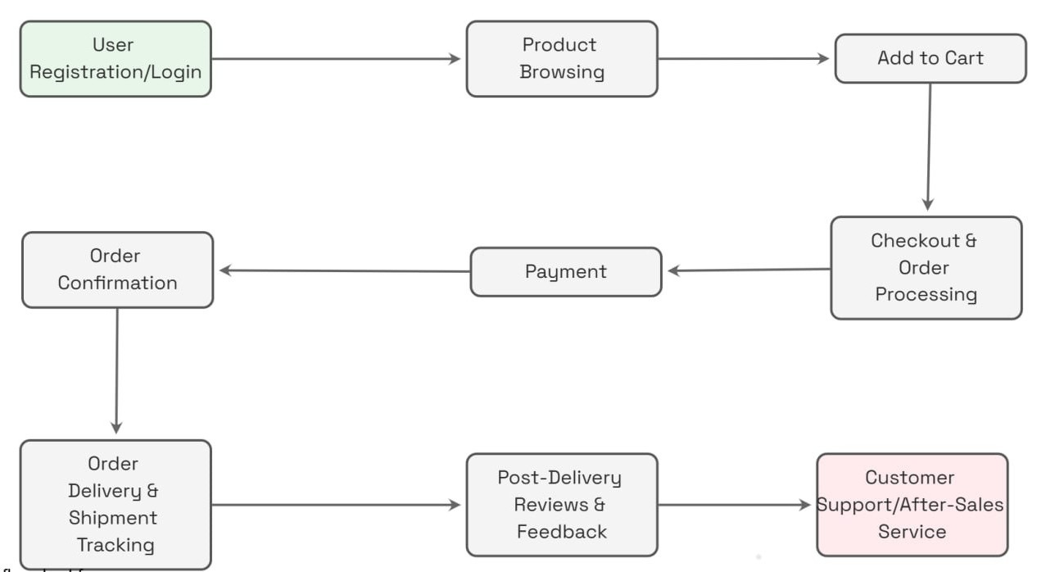
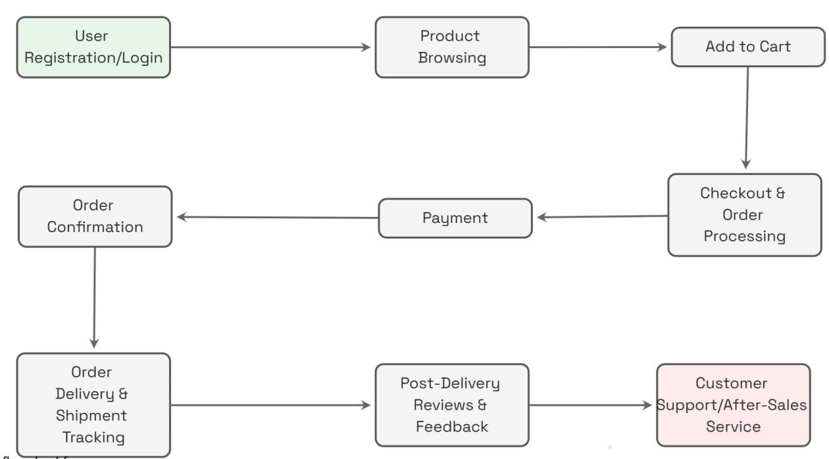
Flowchart
Flowchart
22CS016

Slide 10

Algorithm
Algorithm
Functional Completeness:
Successfully implemented all core functionalities: User authentication and profile management.
Product catalog, including product details, variants, and reviews.
Shopping cart, order processing, and payment handling. Administrative functions such as category and permission management.
API Performance & Reliability:
All API endpoints tested using Postman returned expected results.
CRUD operations for every module (users, products, orders, reviews, etc.) are working as intended.
Average response time is within acceptable limits, ensuring a smooth user experience.
User Experience & Interface:
The application is fully responsive and user-friendly. Screenshots from the front-end demonstrate a clean, modern design and intuitive navigation.
22CS016

Slide 11

Result
Result
Code Quality & Architecture:
Follows the MVC architecture:
Models: Encapsulate database logic.
Controllers: Handle business logic and API responses. Routes: Organize API endpoints clearly.
Proper error handling and use of asynchronous
programming (async/await) ensures robust performance.
Testing & Validation:
Extensive testing using Postman to validate API endpoints.
Automated tests (if implemented) for critical functionalities.
Future Enhancements:
Integration of real-time notifications.
Advanced search and filtering options for products. Further performance optimizations for scalability.

Slide 12

Conclusion
Conclusion
Summary:
Developed a robust, full-stack e-commerce website for clothing.
Achieved a modular and scalable architecture using industry-standard practices.
Key Takeaways:
Mastery of Node.js, Express, and MySQL for backend development.
Importance of clean code structure and API testing.
Valuable experience in full-stack development and project management.
Future Enhancements:
Integration of additional features (e.g., real-time notifications, advanced search).
Further optimization and mobile responsiveness improvements.
12

Slide 13
References
Reference
Node.js Documentation – https://nodejs.org/en/docs/ Express.js Guide – https://expressjs.com/
MySQL Documentation – https://dev.mysql.com/doc/ Postman (API Testing) – https://www.postman.com
22CS016

Slide 14
The End
22CS016

